Slide 1

Time Capsule
Letter App
CAPSTONE 2 · IT PROJECT MANAGEMENT
Write it. Lock it. Decide together a year later.
Midterm Team Project · Prof. S S.Kim
October 22, 2026
Presented by: [team member names]
Notes:
Introduce the team and the idea in one sentence: a digital safe where a couple locks honest letters away for a set time, then decides together whether to open them. Mention that this presentation covers the six required deliverables.

Slide 2






Six deliverables, one project
AGENDA
1 Project Plan
2 Contract / Agreement
3 Use Case Modeling
Background, objectives, scope, audience
Specifications, team roles, guidelines
Diagram and detailed specifications
4 Business Process Model
5 Work Breakdown Structure
6 Gantt Chart
Workflow across partners and system
Tasks split into work packages
Schedule, milestones, dependencies
Notes:
Walk through the six required deliverables in order. Each one is a section of this presentation and of the final report.

Slide 3




Why people need a pause button
01 PROJECT PLAN
The problem
Hurt people send angry, emotional messages in the moment.
In the heat of a breakup, one angry text can end any chance of getting back together.
The damage
Those messages ruin the chance of reconciling later.
Some couples think: “maybe we just need time apart.”
The gap
There is no safe place to say what is true, then wait.
Notes:
Background: breakups often produce angry texts that destroy any chance of reconciling. Some couples think maybe they just need time apart. Our app gives them a safe pause.

Slide 4




A digital safe for honest letters
01 PROJECT PLAN
STEP 1
STEP 2
STEP 3
STEP 4
Write
Lock
Wait
Decide
Both partners log in together. Each writes one final, honest letter.
They set a timer, for example 365 days. The app seals the letters. No early opening.
The timer runs. When it ends, the letters do not open on their own.
Both click Unlock: they read the letters. Either says no or stays silent: deleted.
The rule that protects both people: if only one partner wants to open the letters, they are deleted forever.
Notes:
Explain the four steps: write, lock, wait, decide. Emphasise that nobody can open the letters early, and that the letters do not open automatically when the timer ends.

Slide 5

Objectives and scope
01 PROJECT PLAN
Objectives
In scope
1
Build a web app where a couple writes, seals, and later decides whether to reveal letters
Accounts and couple linking
Private letter writing, encrypted storage
Unlock-date timer and notifications
Mutual unlock or delete decision
2
Enforce the lock on the server: no early opening, no admin override
3
Apply the both-must-agree rule: any No or no reply means permanent deletion
Out of scope
4
Plan and deliver the project in 12 weeks with five milestones
Chat between partners, counselling or matchmaking, native mobile apps, payments
Notes:
Four objectives on the left. On the right, what is in scope and what we deliberately leave out so the project stays achievable in 12 weeks.

Slide 6

Who it is for
01 PROJECT PLAN
Stakeholder | What they need
Couples (users) | A safe, private and trustworthy pause
Project team | A clear plan, delivered on time and on scope
Instructor, Prof. S S.Kim | Complete, well-modeled deliverables
External services | Encryption and push notification providers work reliably
Target audience
Couples who think “maybe we just need time apart”
Both partners use the app together, each from their own account.
Notes:
The primary audience is couples going through a break or breakup. The stakeholder table shows who else cares about the outcome.

Slide 7

Project specifications
02 CONTRACT / AGREEMENT
Product | Responsive web application: Time Capsule Letter App
Users | One linked couple: Partner A and Partner B
Core features | Accounts and linking, private letters, unlock timer, mutual decision, notifications
Security and privacy | Letters encrypted at rest, passwords hashed, lock enforced on the server
Duration | 12 weeks, five milestones (M1 to M5)
Deliverables | Plan, contract, use cases, BPM, WBS and Gantt chart
Sealed until the date
Both must agree
Otherwise deleted
No early opening, no admin override
Both click Unlock to read the letters
A No or no reply erases them forever
Notes:
This is what we agree to build. The three rules at the bottom are non-negotiable and shape every model that follows.

Slide 8





Team roles and responsibilities
02 CONTRACT / AGREEMENT
Project Manager
Business Analyst
System Designer
Developer
QA and Documentation
Plan and schedule
Track milestones
Coordinate the team
Gather requirements
Use cases and specs
Process model (BPM)
Data model (ERD)
UI/UX wireframes
Design review
Build the web app
Timer and lock logic
Encryption, alerts
Testing and UAT
Final report
Presentation
Every member also reviews and tests, so no deliverable is left to one person.
Notes:
Five roles cover the whole lifecycle. Everyone reviews and tests, so roles can be shared. Names are assigned to roles in the team agreement.

Slide 9



Agreement guidelines
02 CONTRACT / AGREEMENT
Communicate
Weekly team meeting. Replies in the group chat within 24 hours.
Decide together
Majority vote. The project manager breaks ties.
One source of truth
Review before submit
Every deliverable is checked by a second member.
Every deliverable lives in our GitHub repository.
Deliver on time
Milestone dates are shared. Blockers are raised early.
github.com/qudrathamidov18
Control changes
Scope changes need approval from the whole team.
Notes:
These are the working rules the team commits to. The GitHub repository is the single source of truth for every deliverable.

Slide 10
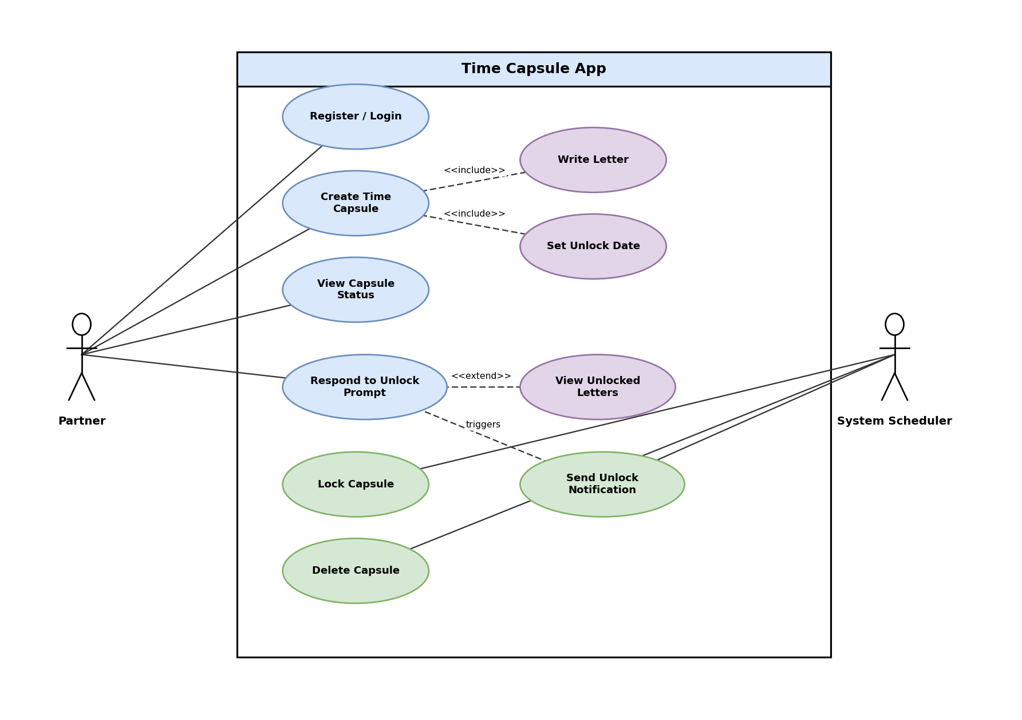
Two actors, ten use cases
03 USE CASE MODELING
PARTNER
Register / Login
Create Time Capsule (includes Write Letter, Set Unlock Date)
View Capsule Status
Respond to Unlock Prompt (extended by View Unlocked Letters)
SYSTEM SCHEDULER
Lock Capsule
Send Unlock Notification
Delete Capsule
Notes:
The Partner starts every action. The System Scheduler runs three automatic use cases: lock, notify, and delete. Create Time Capsule includes Write Letter and Set Unlock Date.

Slide 11
UC-02: Create Time Capsule
03 USE CASE MODELING
Main flow
ID AND NAME
UC-02 Create Time Capsule
ACTORS
Partner A and Partner B (linked couple)
INCLUDES
UC-03 Write Letter, UC-04 Set Unlock Date
PRECONDITIONS
Both partners are logged in and linked as a couple
POSTCONDITIONS
Letters are locked; the unlock date can no longer change
Each partner writes a private final letter (UC-03).
Partners agree on an unlock date, e.g. 365 days (UC-04).
System warns: “Once sealed, no one can open this early.”
Both partners confirm.
System encrypts and locks the letters (UC-08).
Capsule status changes to Sealed.
Exceptions
A letter is unfinished: the capsule stays in Draft.
A partner cancels at confirmation: nothing is sealed.
Notes:
Walk the main flow top to bottom. Point out the warning before sealing, and that after step 5 the unlock date can no longer be changed.

Slide 12
UC-06: Respond to Unlock Prompt
03 USE CASE MODELING
Main flow
ID AND NAME
UC-06 Respond to Unlock Prompt
ACTORS
Partner A and Partner B; started by the System Scheduler
EXTENDED BY
UC-07 View Unlocked Letters
PRECONDITIONS
Capsule is Sealed, unlock date reached, both notified
POSTCONDITIONS
Letters revealed to both, or permanently deleted
Partner opens the unlock notification (UC-09).
System explains the rule and shows Unlock or Decline.
Partner chooses Unlock and confirms.
System records the decision and waits for the other partner.
When both chose Unlock, the letters are revealed (UC-07).
Exceptions
Either partner declines, or no reply in the response window:
the capsule is deleted and both letters are erased forever (UC-10).
Notes:
This is the heart of the project. Stress that both partners must choose Unlock. Any decline or silence leads to deletion.

Slide 13

UC-08 to UC-10: the System Scheduler
03 USE CASE MODELING
UC-08 Lock Capsule
UC-09 Send Unlock Notification
UC-10 Delete Capsule
TRIGGER
Both partners confirm sealing
WHAT THE SYSTEM DOES
Encrypts both letters (Encryption Service)
Stores them, sets status Sealed
Blocks every read until the date
RESULT
No early opening, not even for admins
TRIGGER
The unlock date is reached
WHAT THE SYSTEM DOES
Scheduler checks the capsule
Sends in-app and push alerts
Starts the response window
RESULT
Both partners are asked to decide; letters stay closed
TRIGGER
A partner declines, or the window ends
WHAT THE SYSTEM DOES
Erases both letters permanently
Marks the capsule Deleted
Shows a gentle farewell message
RESULT
Nothing can be recovered by anyone
All three run automatically. No user action, no admin override.
Notes:
These three use cases run without any user action. They are what makes the lock real: encrypt and seal, notify at the right time, and delete when the rule says so.

Slide 14
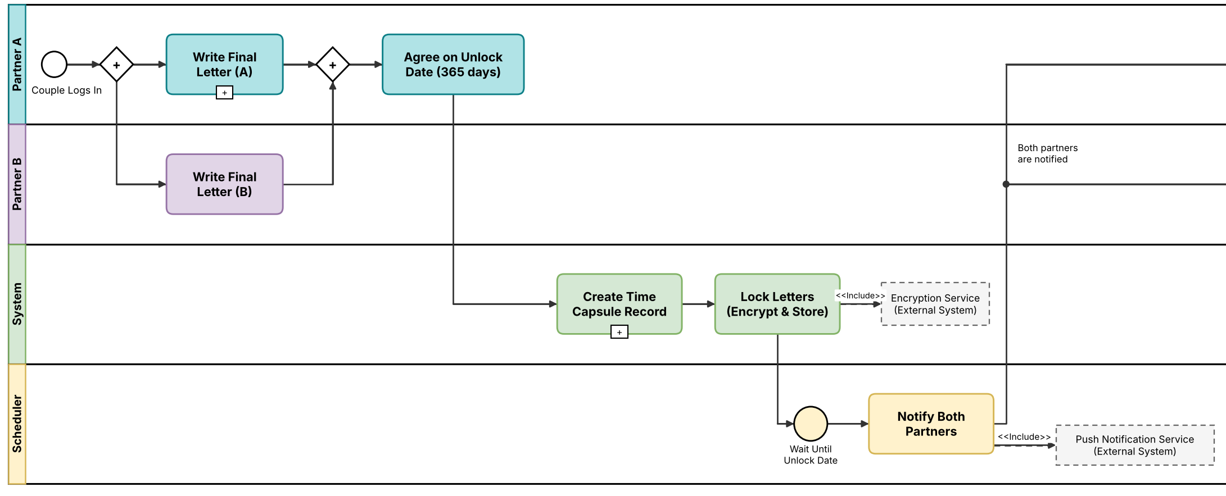
Writing and sealing run in parallel
04 BUSINESS PROCESS MODEL
Notes:
Read the model left to right. After login, a parallel gateway lets both partners write at the same time. When both letters exist they agree a date, the system creates the capsule record and locks the letters through the Encryption Service. The scheduler then waits for the unlock date.

Slide 15
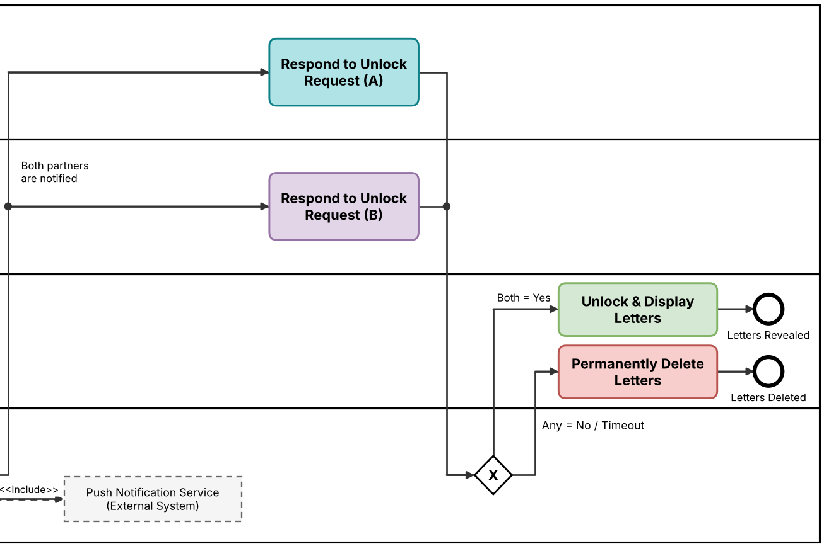
The unlock decision decides everything
04 BUSINESS PROCESS MODEL
Timer
Waits until the unlock date
Both = Yes
Letters unlock and are shown
Any = No or timeout
Letters are deleted forever
Notes:
After the timer ends the scheduler notifies both partners. Each responds to the unlock request. An exclusive gateway then checks the answers: both yes reveals the letters; any no, or no reply, deletes them permanently.

Slide 16
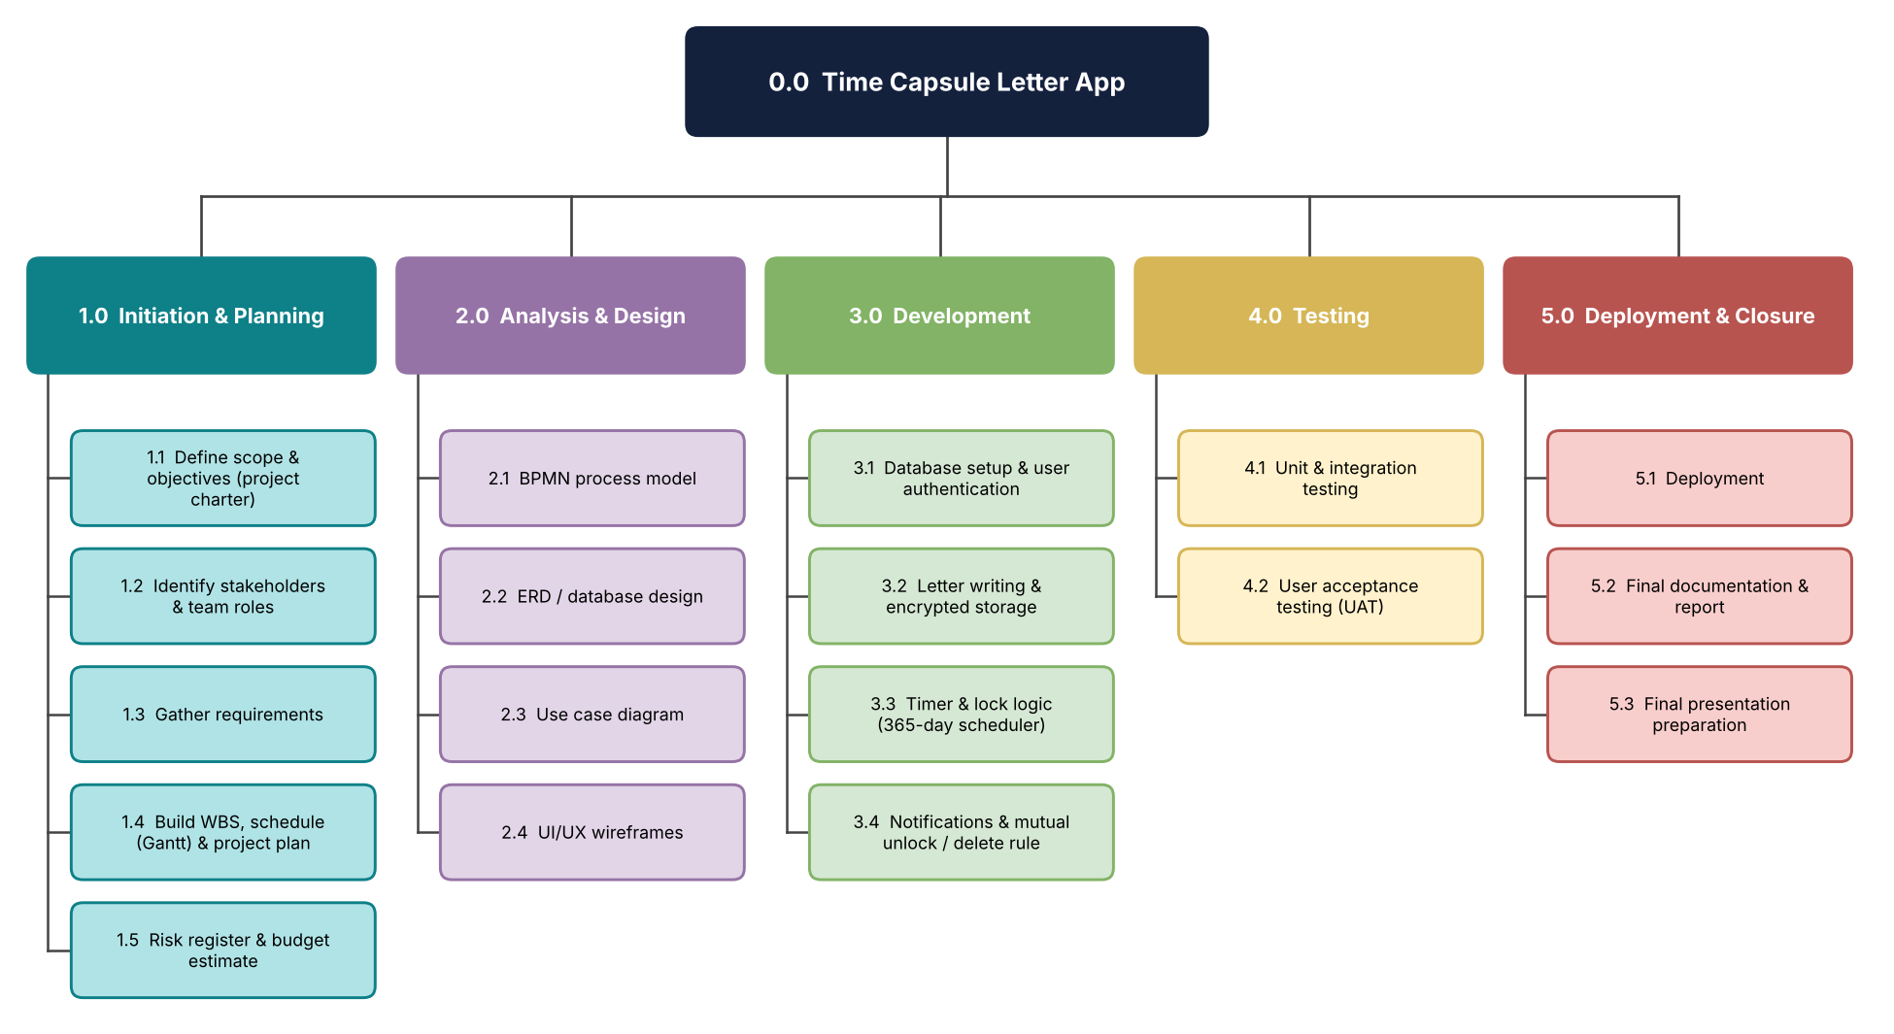
From one project to 18 work packages
05 WORK BREAKDOWN STRUCTURE
5
phases
18
work packages
Notes:
The project breaks into five phases and 18 work packages. The same packages appear as bars in the Gantt chart, so the WBS and the schedule match.

Slide 17
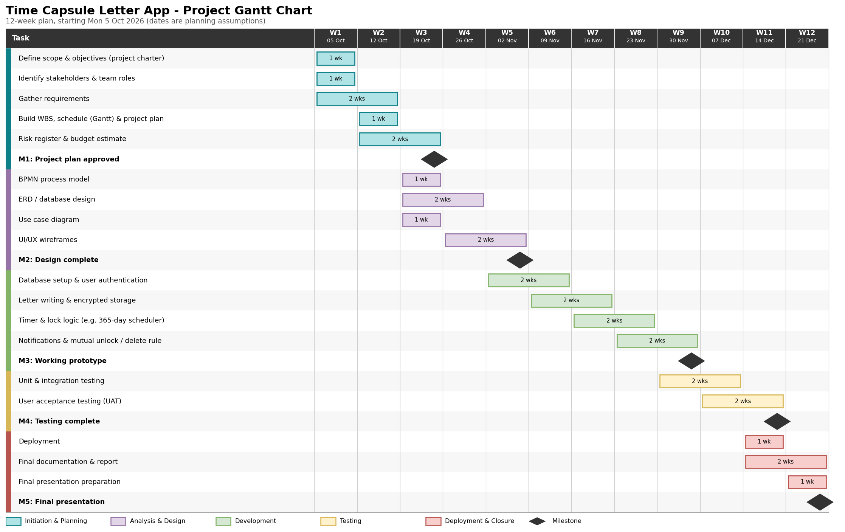
A 12-week plan with five milestones
06 GANTT CHART
12
weeks
18
tasks
5
milestones
Notes:
The plan starts Monday 5 October 2026 and ends Friday 25 December 2026. Colors match the five WBS phases. Diamonds are milestones.

Slide 18
Milestones and dependencies
06 GANTT CHART
M1
M2
M3
M4
M5
Week 3 · Fri 23 Oct
Week 5 · Fri 6 Nov
Week 9 · Fri 4 Dec
Week 11 · Fri 18 Dec
Week 12 · Fri 25 Dec
Project plan approved
Design complete
Working prototype
Testing complete
Final presentation
Key dependencies (finish to start)
Requirements
Models and design
Build, staggered weekly
Testing and UAT
Deploy and report
WBS 1.3
WBS 2.1 to 2.4
WBS 3.1 to 3.4
WBS 4.1 to 4.2
WBS 5.1 to 5.3
Critical path: a delay in development moves the final presentation (M5), so testing keeps a buffer.
Notes:
Each milestone closes a phase. The critical path runs through requirements, design, development, testing, and deployment. Any delay in development moves the final presentation.

Slide 19
Four risks and how we handle them
PROJECT RISKS
Risk | Impact | Mitigation
A browser-only lock could be bypassed | High | Enforce the lock on the server; the date cannot change after sealing; no admin override
Letters leak or are read by the wrong person | High | Encrypt letters at rest, hash passwords, keep only the data we need
One partner stops replying after the unlock date | Medium | Fixed response window; the deletion rule is explained before sealing
Development falls behind the Gantt chart | Medium | Staggered weekly tasks, a testing buffer, weekly progress check against the plan
Notes:
The two high-impact risks are about trust: the lock must be real, and the letters must stay private. The medium risks are about people and schedule.

Slide 20


Six deliverables,
ready for review
Project plan
Contract and agreement
Use case models and specifications
Business process model
Questions?
Work breakdown structure
github.com/qudrathamidov18
Gantt chart and schedule
Notes:
Recap: all six deliverables are complete and in our GitHub repository. Invite questions.

Slide 21
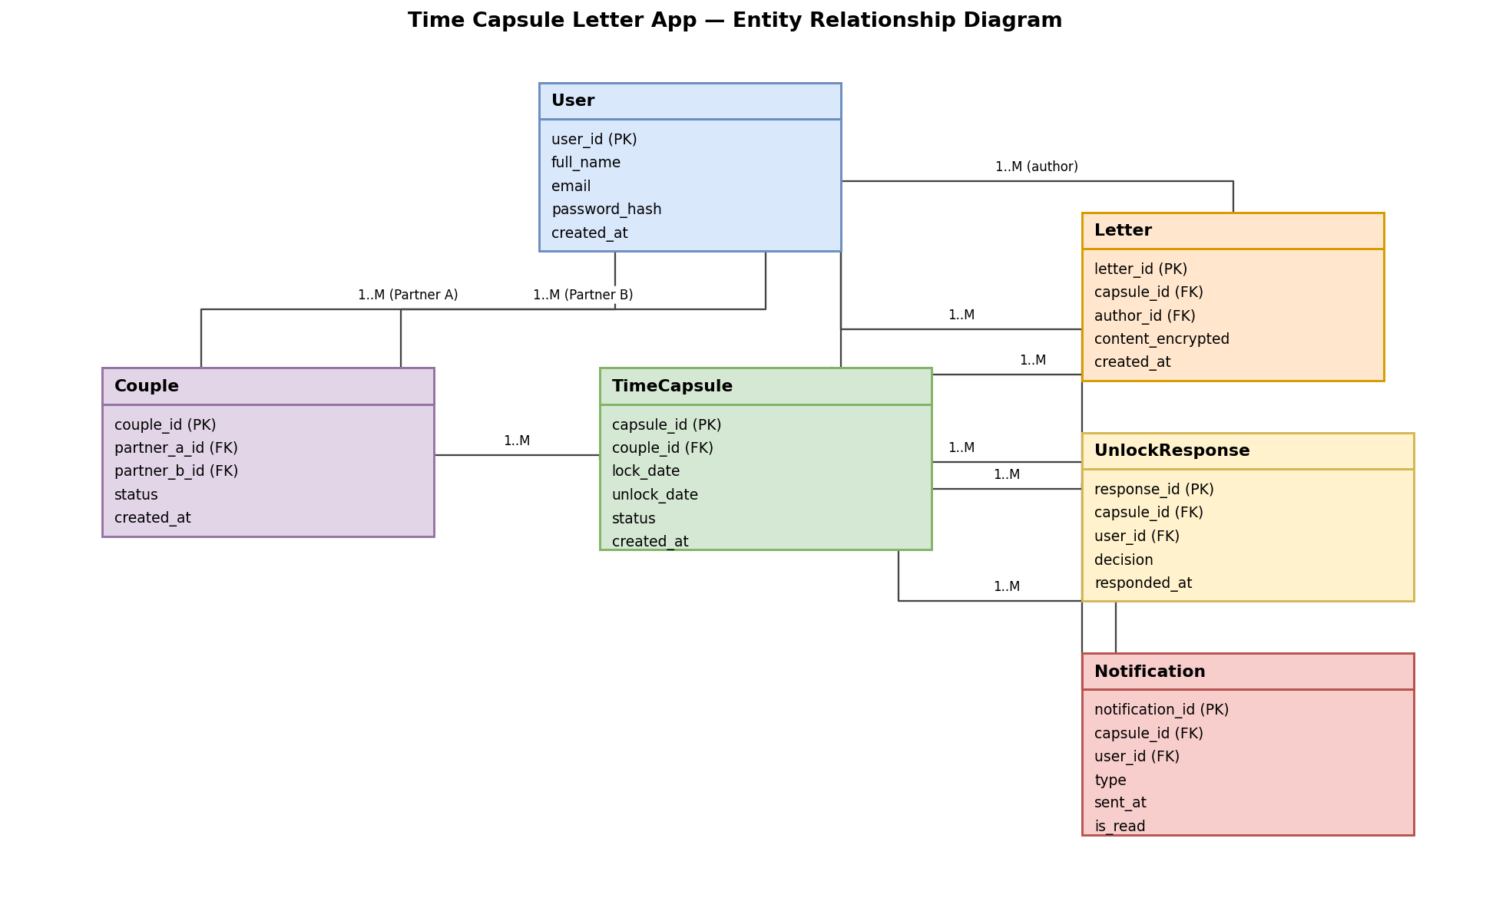
Appendix: data model (ERD)
SUPPORTING MODEL
User: account details
Couple: links two users
TimeCapsule: lock and unlock dates, status
Letter: encrypted content
UnlockResponse: each partner's decision
Notification: alerts sent to partners
Notes:
Backup slide in case of questions about storage. Letter content is stored encrypted, and UnlockResponse records each partner's decision.

